Slide 1
MECM Admin Role Support
Shashikanth & Yangyang

Slide 2
Requirement description
【Mecm】Mecm应用支持分权控制，区分不同角色进行差异化功能展现MECM Support
Administrator/Tenant/Guest Role
MECM Administrator Role:
Administration role support is required to have better control over underlying infrastructure and also resources of all the tenants.
Currently MECM support following roles
Tenant already supported in v0.9
Guest already supported in v1.0

Slide 3
MECM Architecture
MECM Portal
Management
Common services
APPO
APM
Platform manager
Security services
Inventory
Logging
Infra Manager
Placement
Policy&Analytics
DB
MEPM
Rules & Requirement manager
Element manager
LCM Controller
K8sPlugin
3rd party plugin
K8s/Openstack
Impacted modules

Slide 4
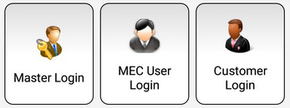
Tenant
Configurations
Administrator
Tenant
Admin
Configure applcm, host, appstore, apprule manager.
Distribute application package
Perform LCM on application
Query distribution status, deployment status, configurations, kpi
1.Distribute application package
2.Perform LCM on application
3.Query distribution status, deployment status, configurations, KPI and capabilities
Configure applcm, host, appstore, apprule manager
=
+

Slide 5

MECM Administrator user role
Selects specific tenant to perform
1.Application package
distribution.
2.Application LCM
operations etc...
Display Host, Applcm, AppruleMgr and Appstore configurations etc...
Admin query available tenants from user-mgmt
Selects specific tenant to view
1. Deployed applications and its status
2. Distributed application
packages and its status
3. Configured application
rules etc...
Display
1. Edge KPI(CPU, MEM, DISK) and
2. Host software
capabilities

Slide 6
Changes to existing MECM Tenant user role
Current:
Tenant: These users have full permission on corresponding tenant it includes
i. Edge configurations(Host, Applcm, Apprule, Appstore).
ii. Application package distribution.
iii. Application LCM operations.
iv. Query host KPI and capabilities.
Query API’s returns data related to a tenant.
New:
Tenant: These users have permission to
i. Distribute Application Package.
ii. Application LCM operations.
iii. Query packages, deployment, host KPI and capabilities.
Tenant
Edge configurations(Host, Applcm, Apprule, Appstore) permission to be removed as hosts are shared among all tenants.

Slide 7
Interface update: configuration APIs
mecm-fe
user-mgmt
appo
inventory
apm
lcm controller
/inventory/v1/applcms
/inventory/v1/hosts
/inventory/v1/appstores
/inventory/v1/apprulemgrs
Configure applcm, host, app rule etc….
Tenant agnostic API’s
preAuthorize request, role MECM_ADMIN is allowed
/inventory/v1/mechosts/{mechost_ip}/k8sconfig
preAuthorize request, role MECM_ADMIN is allowed
Get all Tenants
Select tenant to perform operations
Admin
/apm/v1/tenants/{tenant_id}/packages
On-board application package
preAuthorize request,role MECM_ADMIN/MECM_TENANT is allowed
Instantiate app
/appo/v1/tenants/{tenant_id}/app_instances/{app_instance_id}
preAuthorize request, role MECM_ADMIN/MECM_TENANT is allowed
Modified interfaces

Slide 8
Interface update: Query APIs
mecm-fe
user-mgmt
appo
inventory
apm
Tenant agnostic API’s
GET /inventory/v1/applcms
GET /inventory/v1/hosts
GET /inventory/v1/apprules
GET /inventory/v1/appstores
preAuthorize request, role MECM_ADMIN/MECM_TENANT/MECM_GUEST is allowed
Query applcm, host, app rule etc….
Get all Tenants
Select tenant to perform operations
Admin
Query application package
preAuthorize request, role MECM_ADMIN/MECM_TENANT is allowed
GET /apm/v1/tenants/{tenant_id}/packages
Get app Inst info
GET /appo/v1/tenants/{tenant_id}/app_instance_infos
preAuthorize request, role MECM_ADMIN/MECM_TENANT is allowed
Modified interfaces

Slide 9
Interface update: Query APIs
mecm-fe
user-mgmt
appo
inventory
apm
Lcm controller
preAuthorize request, role MECM_ADMIN/MECM_TENANT/MECM_GUEST is allowed
GET /appo/v1/hosts/{host_ip}/mep_capabilities
Tenant agnostic API’s
GET /appo/v1/hosts/{host_ip}/kpi
preAuthorize request, role MECM_ADMIN/MECM_TENANT/MECM_GUEST is allowed
Modified interfaces

Slide 10
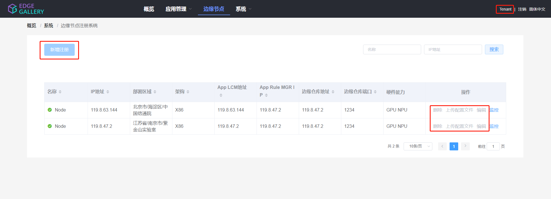
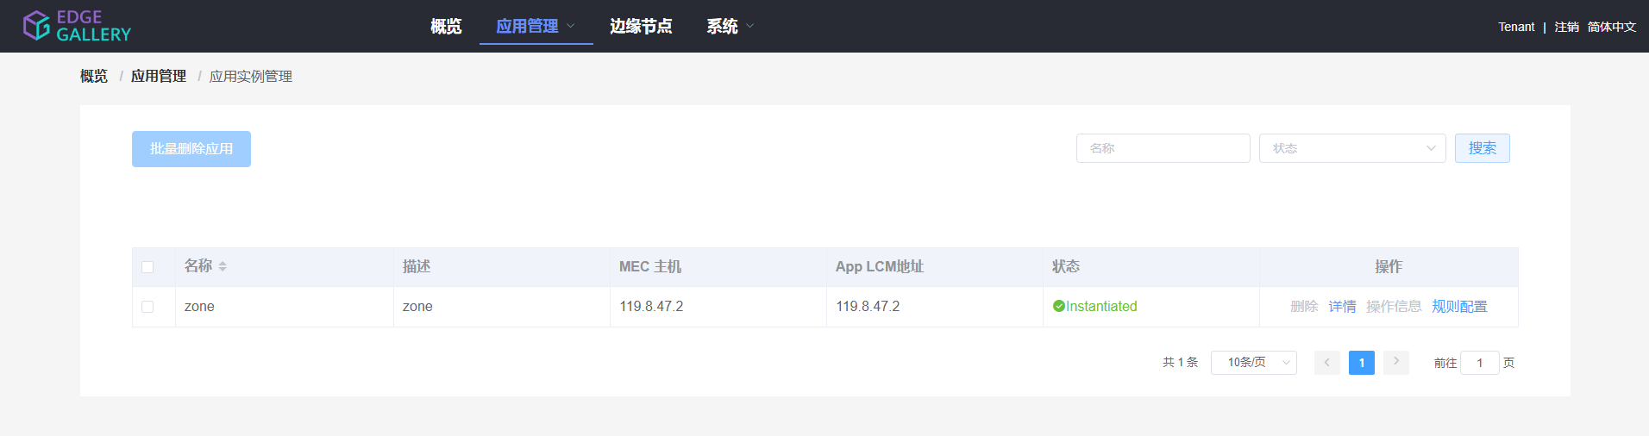
MECM-FE design
Admin：
1.All the operations like before,he can register, modify, delete and upload.
Tenant：
1.System part: can only do the operations like get data belong to themselves, but can not delete and modify, even upload.
2. Package management part: tenant can only get packages, but not terminate.

Slide 11
THANK YOU

Slide 12
Backup Slides

Slide 13
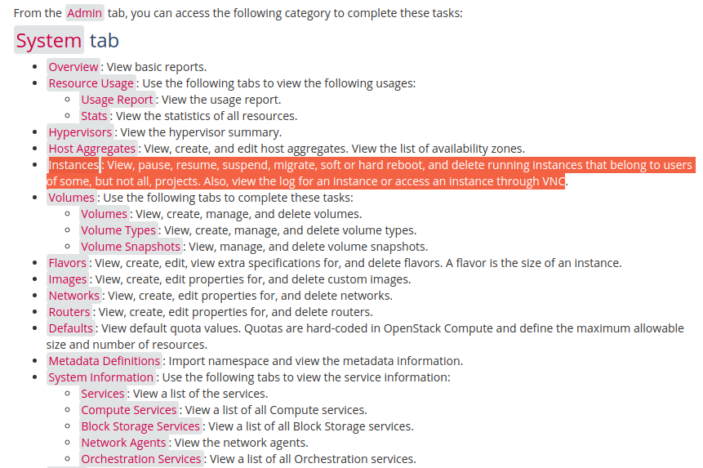
Openstack
Administrative operations¶
The administrator can run any openstack command on behalf of projects by specifying an Identity project
https://docs.openstack.org/ocata/user-guide/dashboard-log-in.html
https://docs.openstack.org/horizon/latest/admin/manage-instances.html
https://docs.openstack.org/horizon/latest/user/launch-instances.html
https://ask.openstack.org/en/question/2032/create-admin-user-within-single-tenant/#:~:text=By%20default%20the%20admin%20role,objects%20owned%20by%20ANY%20TENANT.

Slide 14
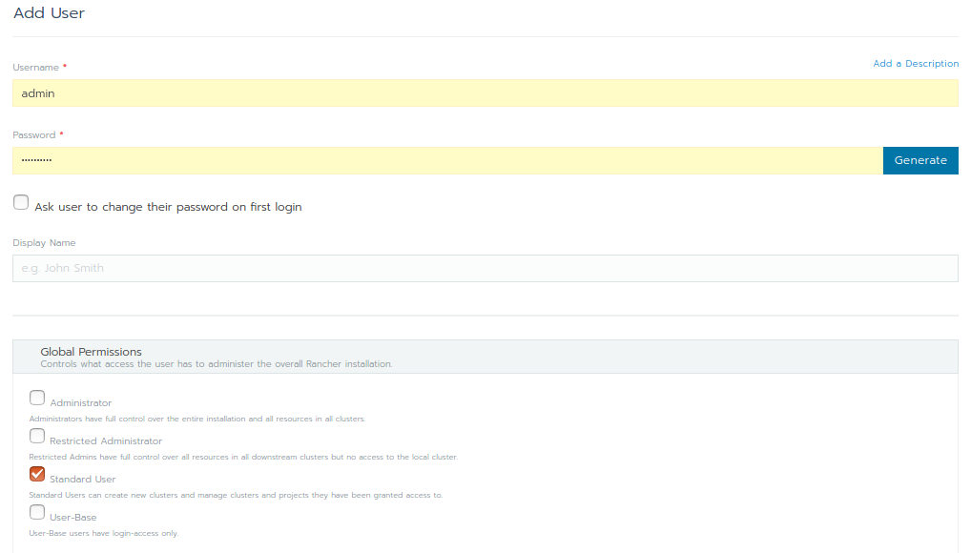
Rancher
Administrator: These users have full control over the entire Rancher system and all clusters within it.
Restricted-admin: role was created in Rancher v2.5 in order to prevent privilege escalation from the local Rancher server Kubernetes cluster. This role has full administrator access to all downstream clusters managed by Rancher, but it does not have permission to alter the local Kubernetes cluster.
Standard User: These users can create new clusters and use them.
User-Base: User-Base users have login-access only.

Slide 15
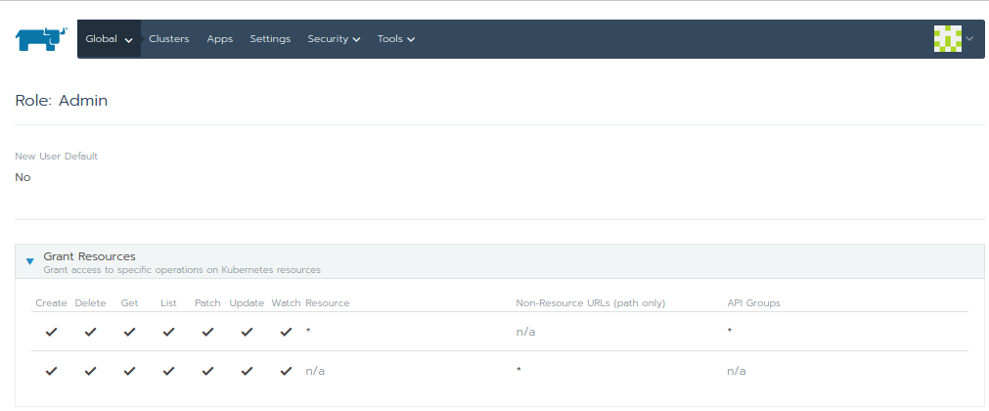
https://www.youtube.com/watch?v=-ZhiaF6BD5o

Slide 16
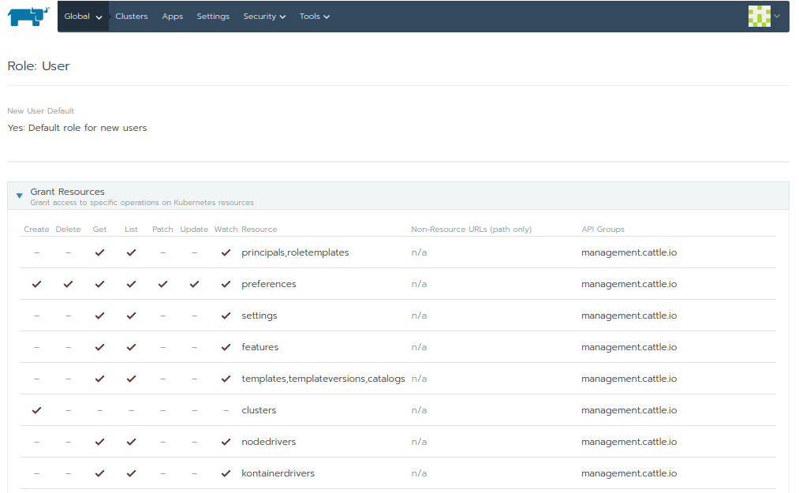
https://rancher.com/docs/rancher/v2.x/en/cluster-admin/cluster-access/cluster-members/?query=project
https://rancher.com/docs/rancher/v2.x/en/deploy-across-clusters/multi-cluster-apps/

Slide 17
New MECM Administrator user role support
MECM-FE has to query user-mgmt for the available tenants
Administrator: These users have full permission on all tenants it includes
i. Edge configurations(Host, Applcm, Apprule, Appstore) for selected tenant.
ii. Application package distribution for selected tenant.
iii. Application LCM operations for selected tenant.
iv. Query host KPI and capabilities for selected tenant.
v. Query distribution status of application packages of all tenants.
vi. Query application instance info records of all tenants.
vii. Query edge configurations(Host, Applcm, Apprule, Appstore) of all tenants.
Edge configurations(Host, Applcm, Apprule, Appstore) permission should be allowed only to admin as admin has better understanding of underlying infra and is shared among all tenants.
Admin

Slide 18
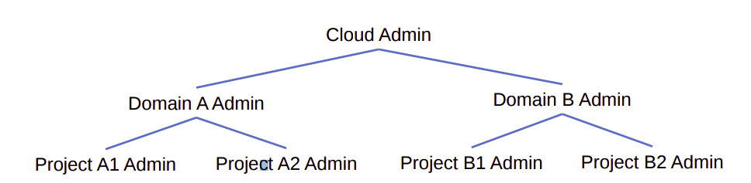
Administrators(system admin, project admin, domain admin)
Users with admin on the system should be able to manage every aspect of the deployment.
Users with admin on a project shouldn’t be able to manage things outside the project because it would violate the tenancy of their role assignment
System administrators are allowed to manage every resource
System administrators are typically operators and cloud administrators. They can control resources that ultimately affect the behavior of the deployment. For example, they can add or remove services and endpoints in the catalog, create new domains, add federated mappings, and clean up stale resources, like a user’s application credentials or trusts.
Domain Administrators:
Domain administrators can manage most aspects of the domain or its contents. These users can create new projects and users within their domain. They can inspect the role assignments users have on projects within their domain.
Domain administrators aren’t allowed to access system-specific resources or resources outside their domain. Users that need control over project, group, and user creation are a great fit for domain administrators.
https://docs.openstack.org/ocata/user-guide/dashboard-log-in.html

Slide 19
Guest

Slide 20
Backup slides

Slide 21
MECM Administrator user role support - soln 1
Allow Admin to have full access rights on all tenant’s resources.
Allow Admin to view all the tenants (query user-mgmt for all tenants info).
Allow Admin to perform app/update/delete action(config/lcm) on any selected tenant.
Allow admin to view configurations, distribution/deployment info of all tenants.
Allow admin to add/update/delete edge configuration i.e, Applcm, AppruleMgr, AppStore, MecHost for a particular tenant.
Note: Allow only admin to create edge configurations(applcm, apprule, mechost, appstore).

Slide 22
Interface change to support admin operations.
Allow admin to add/update/delete edge configuration i.e, Applcm, AppruleMgr, AppStore, MecHost for a particular selected tenant with role as MECM_admin in the token.
mecm-fe has to form mecm-be URL’s with the admin selected tenant ID for any actions (edge config i.e, Applcm, AppruleMge, AppStore, MecHost, application lcm operations and app rule configurations) or can delete tenant-id from URL’s and make tenant-id part of header.
mecm-be should provide new interface to query all the tenants configurations, distribution info and deployment informations etc… when user role is MECM_admin in the token
Modify all query interfaces to include tenant id in the response body.

Slide 23
MECM Administrator user support - Soln 2
Allow Admin to have full access rights on tenants resources.
Allow admin to view configurations, distribution/deployment info of all tenants.
Allow Admin to perform update/delete action(config/lcm) on selected resource.
Note: Allow only tenants to perform edge configurations (applcm, apprule, appstore, mechost).

Slide 24
Interface change to support admin operations.
Allow admin to update/delete edge configuration i.e, Applcm, AppruleMgr, AppStore, MecHost for a particular selected resource with role as MECM_admin in the token.
mecm-fe has to form mecm-be URL’s with the selected tenant resource for any actions (edge config i.e, Applcm, AppruleMge, AppStore, MecHost, application lcm operations and app rule configurations) or can delete tenant-id from URL’s and make tenant-id part of header.
mecm-be should provide new interface to query all the tenants configurations, distribution info and deployment informations etc… when user role is MECM_admin in the token
Modify all query interfaces to include tenant id in the response body of all the queries.

Slide 25
Soln -2 : Interface change to support admin operations.
Need modification in existing configurations APIs
Allow admin to configuration edge configurations i.e, Applcm, AppruleMgr, AppStore, MecHost at global level.
mecm-be should provide new interface to query all the tenants configurations, distribution info and deployment informations etc… when authorization role is MECM_admin in the token
Modify all query interfaces to include tenant id in the response body of all the queries.

Slide 26
Soln 2: Interface changes
Existing APIs
Modified APIs
GET /inventory/v1/tenants/{tenant_id}/applcms
GET /inventory/v1/tenants/{tenant_id}/applcms/{applcm_ip}
PUT /inventory/v1/tenants/{tenant_id}/applcms/{applcm_ip}
POST /inventory/v1/tenants/{tenant_id}/applcms
DELETE /inventory/v1/tenants/{tenant_id}/applcms
DELETE /inventory/v1/tenants/{tenant_id}/applcms/{applcm_ip}
GET /inventory/v1/tenants/{tenant_id}/appstores
POST /inventory/v1/tenants/{tenant_id}/appstores
DELETE /inventory/v1/tenants/{tenant_id}/appstores
GET /inventory/v1/tenants/{tenant_id}/appstores/{appstore_ip}
PUT /inventory/v1/tenants/{tenant_id}/appstores/{appstore_ip}
DELETE /inventory/v1/tenants/{tenant_id}/appstores/{appstore_ip}
GET /inventory/v1/tenants/{tenant_id}/mechosts
POST /inventory/v1/tenants/{tenant_id}/mechosts
DELETE /inventory/v1/tenants/{tenant_id}/mechosts
GET /inventory/v1/tenants/{tenant_id}/mechosts/{mechost_ip}
PUT /inventory/v1/tenants/{tenant_id}/mechosts/{mechost_ip}
DELETE /inventory/v1/tenants/{tenant_id}/mechosts/{mechost_ip}
GET /inventory/v1/tenants/{tenant_id}/mechosts/{mechost_ip}/capabilities
GET /inventory/v1/tenants/{tenant_id}/mechosts/{mechost_ip}/capabilities/{capability_type}/applications
POST /inventory/v1/tenants/{tenant_id}/mechosts/{mechost_ip}/k8sconfig
DELETE /inventory/v1/tenants/{tenant_id}/mechosts/{mechost_ip}/k8sconfig
GET /inventory/v1/tenants/{tenant_id}/apprulemanagers
GET /inventory/v1/tenants/{tenant_id}/apprulemanagers/{app_rule_manager_ip}
DELETE /inventory/v1/tenants/{tenant_id}/apprulemanagers
DELETE /inventory/v1/tenants/{tenant_id}/apprulemanagers/{app_rule_manager_ip}
GET /inventory/v1/applcms
GET /inventory/v1/applcms/{applcm_ip}
PUT /inventory/v1/applcms/{applcm_ip}
POST /inventory/v1/applcms
DELETE /inventory/v1/applcms
DELETE /inventory/v1/applcms/{applcm_ip}
GET /inventory/v1/appstores
POST /inventory/v1/appstores
DELETE /inventory/v1/appstores
GET /inventory/v1/appstores/{appstore_ip}
PUT /inventory/v1/appstores/{appstore_ip}
DELETE /inventory/v1/appstores/{appstore_ip}
GET /inventory/v1/mechosts
POST /inventory/v1/mechosts
DELETE /inventory/v1/mechosts
GET /inventory/v1/mechosts/{mechost_ip}
PUT /inventory/v1/mechosts/{mechost_ip}
DELETE /inventory/v1/mechosts/{mechost_ip}
GET /inventory/v1/mechosts/{mechost_ip}/capabilities
GET /inventory/v1/mechosts/{mechost_ip}/capabilities/{capability_type}/applications
POST /inventory/v1/mechosts/{mechost_ip}/k8sconfig
DELETE /inventory/v1/mechosts/{mechost_ip}/k8sconfig
GET /inventory/v1/apprulemanagers
GET /inventory/v1/apprulemanagers/{app_rule_manager_ip}
DELETE /inventory/v1/apprulemanagers
DELETE /inventory/v1/apprulemanagers/{app_rule_manager_ip}

